Slide 1

SRI KRISHNA ARTS AND SCIENCE COLLEGE
Department of Software Systems and AIML
III M.Sc. SS
SEMESTER - VI
23SSI39- Mini Project
Title: Rewordly
Guide Name: Dr. M. Raju M.Sc.,Ph.D.,
Assistant Professor
Student Roll number: 23MSS059
Student Name: THRANAESWANTH S

Slide 2
Abstract
• Rewordly is a web-based text rewriting system.
• The system helps users improve sentence clarity and readability.
• Users can enter text and receive a better rewritten version.
• The project is developed using HTML, CSS, JavaScript, and MySQL.
• The main goal is to improve communication quality through an easy web
interface.
46f7qsxi

Slide 3
Introduction
46f7qsxi
• Clear communication is very important in digital platforms.
• Many users find it difficult to rewrite sentences clearly.
• Traditional tools mostly focus on grammar correction.
• They do not effectively improve sentence structure.
• Rewordly provides a simple solution to rewrite and improve text.

Slide 4
Existing Methodology
46f7qsxi
• Traditional text editors require manual rewriting.
• Most tools only check spelling and grammar.
• Limited support for improving sentence structure.
• Some tools are complex and difficult to use.
Problems in existing systems:
• Time consuming • Limited rewriting support • Poor user experience

Slide 5
Proposed Methodology
46f7qsxi
• Rewordly provides a simple web-based rewriting platform.
• Users can easily input text through the website.
• The system processes the input and improves sentence structure.
FEATURES OF THE PROPOSED SYSTEM:
• Easy to use interface • Fast text processing • Improved sentence clarity
• Better readability

Slide 6
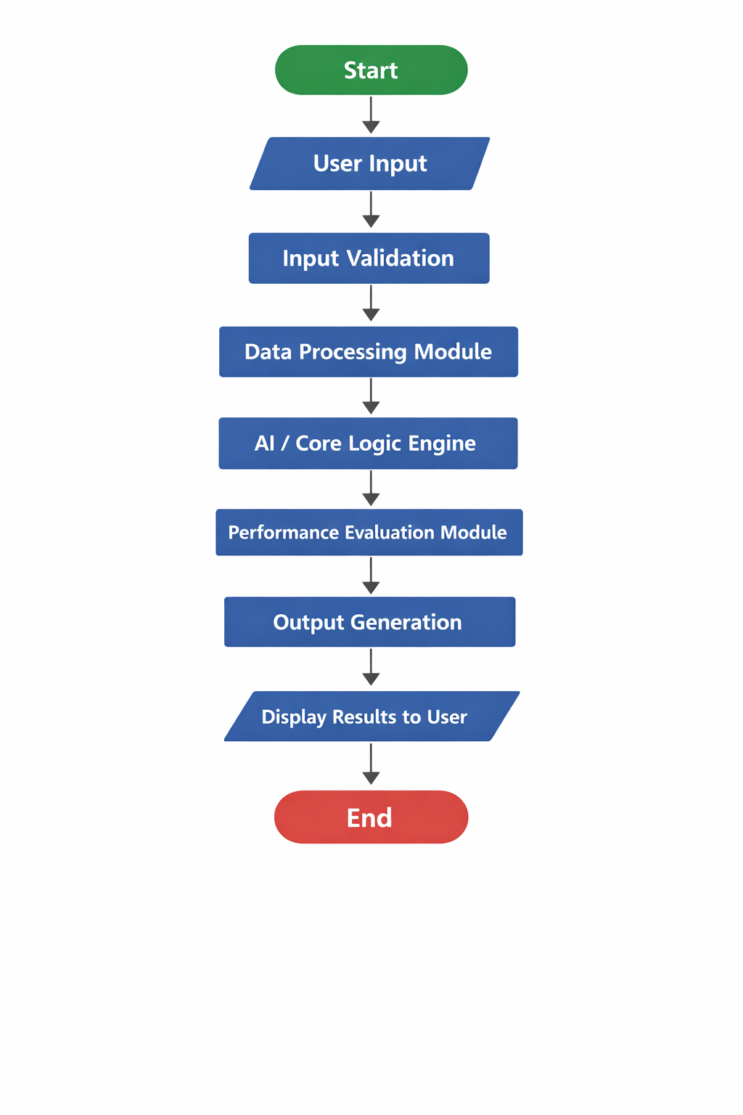
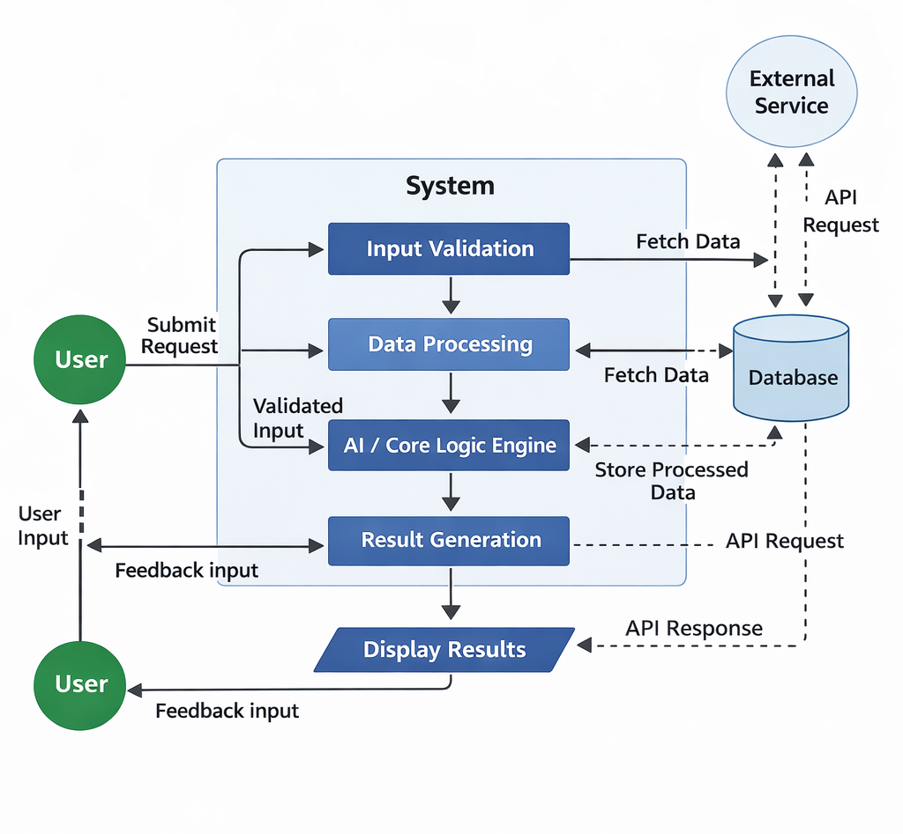
Flow of Process
46f7qsxi
SYSTEM FLOW DIAGRAM : DATA FLOW DIAGRAM :

Slide 7
Technical Method
rewordly
Frontend Technologies
• HTML – Used to create the structure of web pages
• CSS – Used for styling and layout design
• JavaScript – Used for interaction and text processing
Database
• MySQL – Used to store user data and system information
Additional Technical Features
• Client-side Processing – JavaScript processes user input quickly without reloading the page.

Slide 8
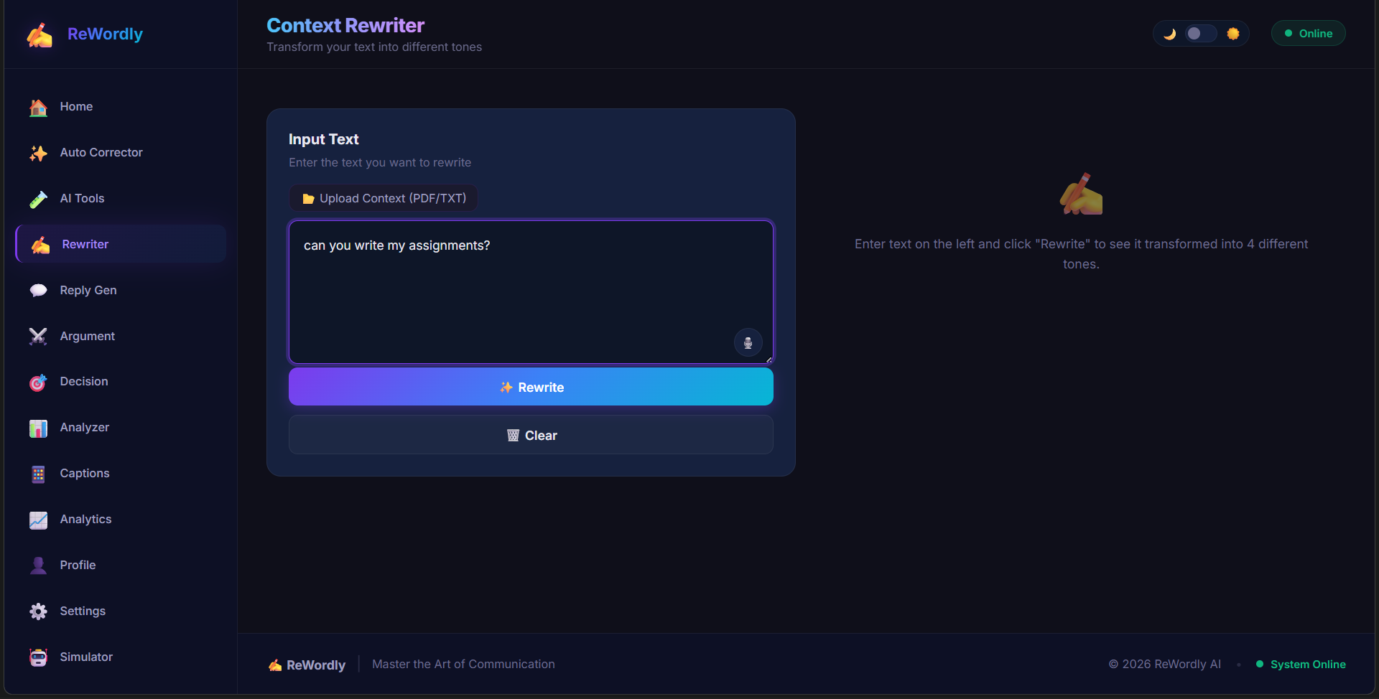
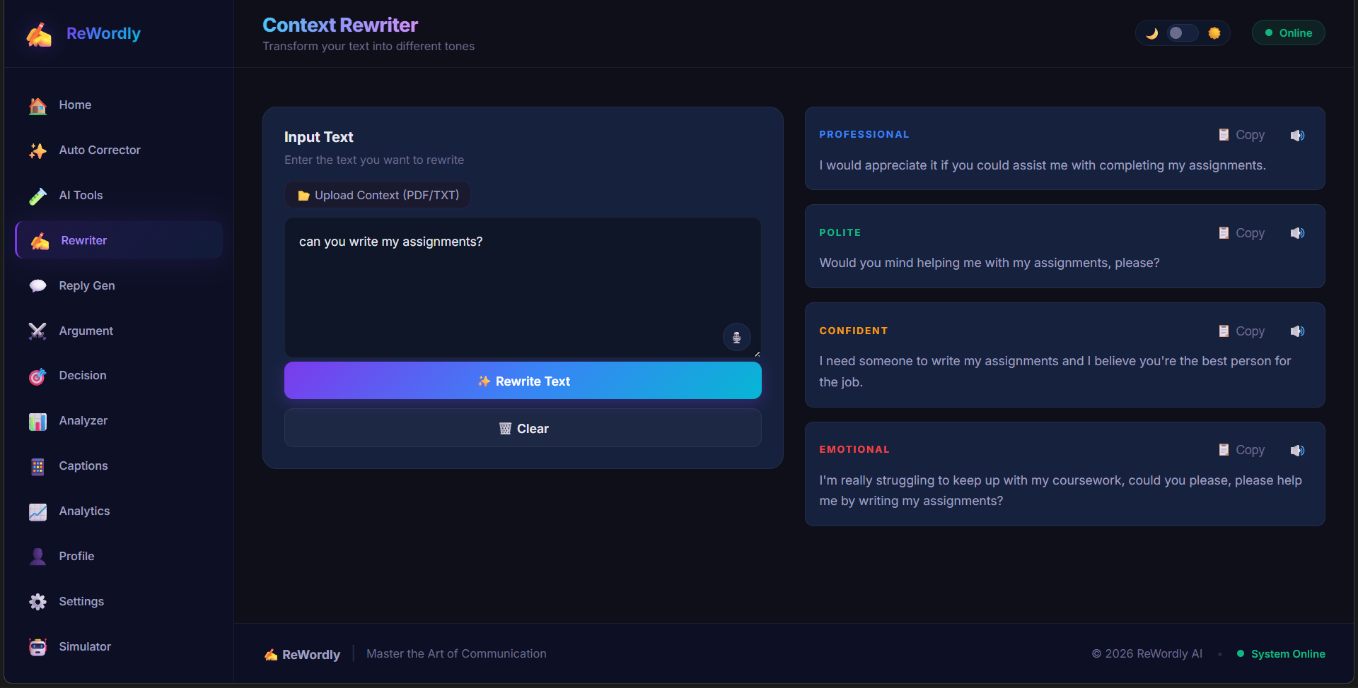
Input/Output Design
46f7qsxi
Input : User types a sentence Output : The rewriter,rewrites the
sentence in 4 different ways

Slide 9
46f7qsxi
Conclusion
• Rewordly helps users improve sentence clarity and readability.
• The system provides a simple and efficient text rewriting platform.
• It uses web technologies like HTML, CSS, JavaScript, and MySQL.
• The platform improves communication and writing quality.
• Future improvements may include AI-based text rewriting.

Slide 10
_{Thank you}
46f7qsxi

